Slide 1
NAME: KORIR KIBET JOVAN. REG NO : EO24-01-2289/2020. BSC. CIVIL ENGINEERING.
UNIT: CRITICAL THINKING AND COMMUNICATION SKILLS.
UNIT CODE: IGS 4101
TASK: PHOTOGRAPHIC ESSAY ON ISSUE OF POVERTY IN AFRICAN COMMUNITIES.

Slide 2
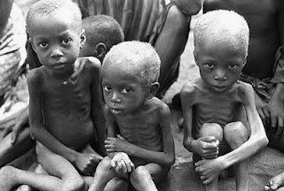
Poverty is a state where a community or individual lacks financial resources and essentials for minimum standard living.
Poverty can be justified by;
Poor housing.
Lack of clean water-poor sanitation
Lack of healthy food-poor diet.
Lack of proper medical attention.
Poor clothing.

Slide 3
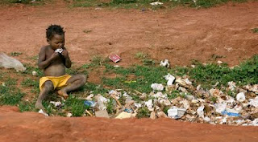
It is a social problem not attributed only to level of income but also race, sexual identity, access to education, government policies and many others.
Some of the causes of poverty include;
Unemployment or underemployment.
Conflicts and wars.
Poor government policies or lack of economic support from government.
Low wages not meeting basic needs demand.

Slide 4
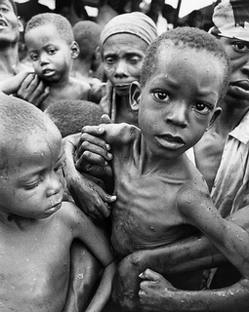
Atimes poverty is determined by socioeconomic status, ethnicity, gender, geographical location. This determines the detriments extremes of poverty.
Health issues reducing peoples earning potentials or productivity.
Economic inequality when it comes to resources distribution.
Discrimination and social exclusion of marginalized groups like women, the disable or LGBTQ individuals.

Slide 5
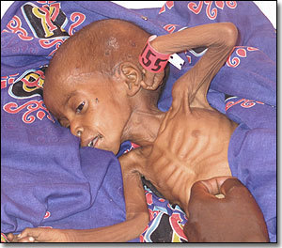
Poverty in most countries is measured using income thresholds. This assist in knowing the population facing the poverty challenge.
Poverty has the following effects;
Causes family problems like divorce due to inability to meet needs.
Increased crimes and violence as people look for illegal illegitimate way of earning.
Health issues due to poor healthcare, housing, diet and sanitation.
Inadequate education and schooling as resources to cater for it are scarce.

Slide 6
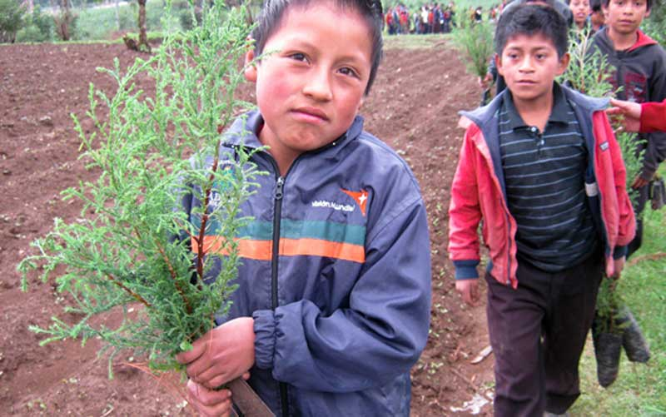
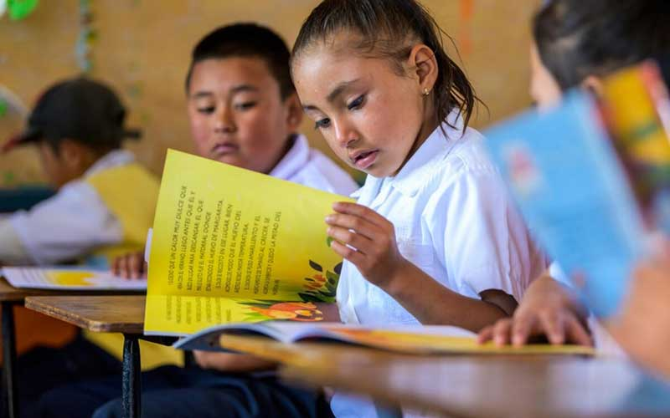
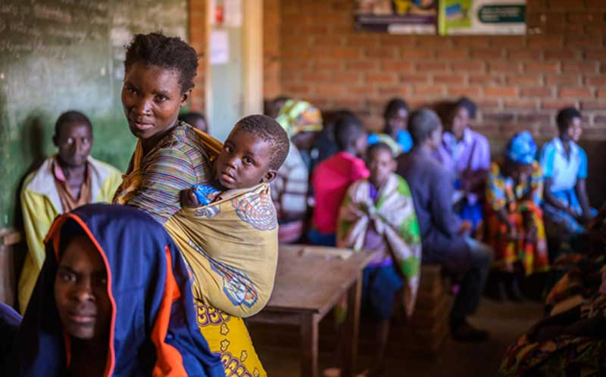
Addressing effects of poverty requires multifaceted approaches that address immediate needs of individual and families facing poverty and factors perpetuating inequality and exclusion.
Some of the solutions to poverty include;
Provision of education to children.
Champion environmental conservation hence reducing climate change chances.
Championing good government policies that facilitate economic growth.
Ensuring accessible and affordable basic healthcare.
Promote gender equality in education, employment and decision marking.

